Slide 1

Lucy the PM
PROGRAM OVERVIEW
EXECUTION SYSTEMS FOR TECH & IMPACT TEAMS
PEOPLE · SKILLS · OPPORTUNITIES · REAL IMPACT
Remote Ready
Kenya
From digital access to paid remote work.
A practical impact programme by Lucy the PM helping people build real remote-work, AI and operational skills through training, guided projects, mentorship and a pathway to meaningful paid opportunities.
Partner with us →
Sponsor a cohort →
Skills everywhere. Opportunities from Kenya to the world.
Remote Ready Kenya by Lucy the PM
01

Slide 2

Lucy the PM
THE GAP
EXECUTION SYSTEMS FOR TECH & IMPACT TEAMS
Digital skills alone
are not enough.
Many talented people learn online, but still struggle to convert learning into legitimate remote work because the missing pieces are practical, social and structural.
Limited practical experience
Weak portfolio evidence
Concepts do not always translate into confidence, client-ready delivery or proof of execution.
Applications need work samples, project stories and credibility — not certificates alone.
Low access to tools
Unclear path to income
Paid tools, templates and workflow systems are often out of reach for early-stage workers.
Learners need coaching, application support, interview preparation and realistic routes to paid work.
Remote Ready Kenya bridges learning and evidence.
Remote Ready Kenya by Lucy the PM
02

Slide 3
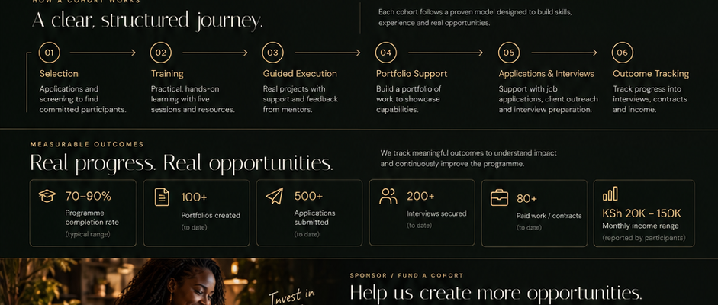
Lucy the PM
PROGRAM MODEL
EXECUTION SYSTEMS FOR TECH & IMPACT TEAMS
A practical, end-to-end pathway
to remote work.
Each cohort follows a structured journey from readiness to guided practice, portfolio proof, applications and outcome tracking.
01
02
03
04
05
06
Selection
Training
Guided execution
Portfolio support
Applications
Outcome tracking
Screening and readiness fit.
Hands-on AI and operations skills.
Real project briefs with support.
Build evidence of real work.
CV, outreach and interviews.
Track contracts, income and feedback.
The goal is not just “training completed.”
The goal is credible work readiness, stronger confidence and a clearer route to paid opportunities.
Remote Ready Kenya by Lucy the PM
03

Slide 4
Lucy the PM
PARTICIPANT SUPPORT
EXECUTION SYSTEMS FOR TECH & IMPACT TEAMS
What participants
receive.
A cohort combines structured learning, practical execution and human support so participants can move beyond theory.
Practical training
Guided projects
Tools & access
Remote work, AI tools and operational workflows.
Realistic briefs to practise delivery and build confidence.
Templates, resources and tools needed to work effectively.
Mentorship
Job readiness
Portfolio building
Guidance from people who understand remote operations.
CV, LinkedIn, outreach, interviews and communication.
Public-safe work samples and stories participants can show.
Proof beats vague potential.
Remote Ready Kenya by Lucy the PM
04

Slide 5
Lucy the PM
OUTCOMES
EXECUTION SYSTEMS FOR TECH & IMPACT TEAMS
Measurable outcomes,
not vague impact claims.
The programme should track real progress in ways funders, partners and participants can understand. Early numbers must be labelled honestly as targets, pilots or verified actuals.
70–90%
100+
500+
200+
80+
KSh 20K–150K
programme completion
portfolios created
applications submitted
interviews secured
paid contracts/jobs
monthly income range
Evidence rule
We will not inflate impact to win funding. The website should clearly separate verified outcomes, pilot figures and future targets.
Remote Ready Kenya by Lucy the PM
05

Slide 6
Lucy the PM
PARTNERSHIP
EXECUTION SYSTEMS FOR TECH & IMPACT TEAMS
How partners and sponsors
can support.
The website should make it easy for partners to express interest, sponsor a cohort, offer tools, mentor, or support placement pathways.
Sponsor a cohort
Support tools & access
Mentor or review work
Create pathways
Fund practical training, mentorship, resources and portfolio support for a defined group.
Provide software, data, subscriptions, templates or work materials.
Help participants sharpen delivery, communication and applications.
Offer projects, paid tasks, referrals, internships or interviews.
Form flow requirement
“Partner with us” opens a form → shows an application-sent message → sends an acknowledgement email to the applicant → sends the details to admin@lucythepm.com.
Remote Ready Kenya by Lucy the PM
06

Slide 7
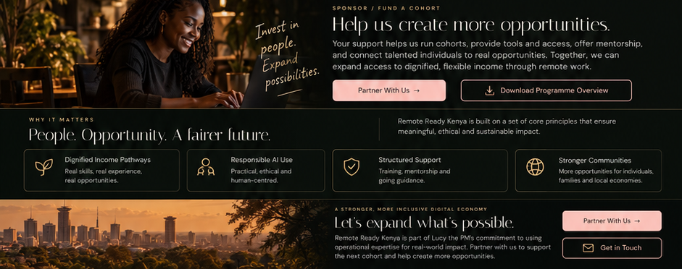
Lucy the PM
DELIVERY PRINCIPLES
EXECUTION SYSTEMS FOR TECH & IMPACT TEAMS
Responsible delivery
principles.
Remote Ready Kenya should help people access opportunity without overpromising, misusing AI or treating participants as marketing props.
Dignified income pathways
Responsible AI use
Structured support
Transparent evidence
Real skills, real experience and real opportunity.
AI as support and productivity, not a shortcut around competence.
Training, mentorship and resources with clear expectations.
Privacy-safe stories and verified numbers only.
Remote Ready Kenya by Lucy the PM
07

Slide 8
Lucy the PM
FUNDING USE
EXECUTION SYSTEMS FOR TECH & IMPACT TEAMS
What funding accelerates.
Support helps us run stronger cohorts, provide tools and mentorship, and build the systems that make impact easier to track and scale.
Training & facilitation
Tools & resources
Mentorship
Platform support
Scaling access
Sessions, curriculum, facilitation and learner support.
Software, templates, subscriptions and learning materials.
Mentor time, reviews and professional support.
Website, reporting, analytics and programme operations.
More cohorts, partner pipelines and more opportunity.
PayPal support links
Add final verified PayPal link(s) before website upload and before public distribution.
Partner with us →
Download overview →
Skills everywhere. Opportunities from Kenya to the world.
Remote Ready Kenya by Lucy the PM
08

